Slide 1
USIU-AFRICA · DSA3050
GLOBAL EXPORT
RESILIENCE
Analysing the Impact of Banking Crises
and Policy Interventions on International Trade
Group C · Angela Irungu · Martin Kyaremateng · Queen Kibegi · Tumaini Micheni · Leona Kamau

Slide 2
EXECUTIVE SUMMARY
39,500+
23
3.41%
0.44
Observations
Countries in Recession
Avg. GDP Growth
Aggregated Risk Score
World Bank dataset
Currently identified
Global benchmark
Systematic risk index
Project Overview
This project evaluates the Global Export Resilience initiative, examining how banking crises affect international trade performance across 39,500+ industry-country observations sourced from the World Bank. Our Business Intelligence solution identifies sectoral vulnerabilities, evaluates policy effectiveness, and maps macro-financial linkages.

Slide 3
RESEARCH FRAMEWORK
Problem Statement
Banking crises create severe liquidity constraints disrupting trade flows. Impact is uneven across industries based on financial dependence (RZ) and asset tangibility (TANG). Limited empirical visibility exists into which sectors are most vulnerable and whether government interventions effectively mitigate damage.
Q1
Q2
Q3
Q4
Q5
Crisis Impact
Sectoral Vulnerability
Policy Effectiveness
Macro-Financial Interaction
Global Sensitivity
How much does export growth drop during a banking crisis vs. stable periods?
Are high-RZ industries more affected by output losses than tangible-asset industries?
Which policy — liquidity support, recapitalization, or debt relief — drives fastest recovery?
Does banking system strength (pcrdbofgdp) influence export decline severity?
How does a foreign recession affect developed vs. developing countries' export share?

Slide 4
DATA & METHODOLOGY
DATA SOURCE
BI LIFECYCLE
Source
World Bank Data Catalog
01
Power Query (ETL)
10+ transformations: null handling, ISO standardization, crisis intensity columns
Total Rows
39,589 observations
02
Star Schema Modeling
Fact_TradePerformance + Dim_Date, Dim_Country, Dim_CrisisStatus
Columns
44 variables
03
DAX Development
Domain
Finance & Banking
15+ measures: YoY, MTD, Recovery Velocity Index, Risk Index
04
Dashboard Visualization
Period
1980 – 2010
4-page executive dashboard with What-If parameters & Decomposition Trees

Slide 5
KEY FINDINGS
Business Intelligence Dashboard Results
Q1 · Crisis Impact
-ve Growth
Q4 · Macro-Financial
USA 5.8K
Export growth repeatedly dips into negative territory during banking crisis windows. Colombia (COL) shows steady credit of 0.29 but growth slowed to 0.11 during recession.
USA shows highest credit depth at 5.8K vs Japan at 3.2K. Higher credit depth supports trade volumes but increases systemic risk — USA carries individual risk component of 0.91.
Q2 · Sectoral Vulnerability
RZ = 0.01
Q5 · Global Sensitivity
1.82 vs 0.45
High RZ-dependence industries concentrated at 0.2–0.4 YoY export growth mark. High-RZ sectors flagged with exposure metric of 0.01 — most sensitive to liquidity constraints.
Developed nations (USA 1.82, Japan 1.03) show higher risk indices than developing nations (Panama 0.45, Jordan 0.45) — integrated economies absorb more global macro shocks.
Q3 · Policy Effectiveness
0.27
Recovery Velocity stands at only 0.27 against an expected growth benchmark of 3.41. Current policy interventions show delayed impact on restoring trade to full potential.

Slide 6
POWER BI DASHBOARD ARCHITECTURE
🌍
Page 1
📊
Page 2
Global Crisis Tracker
Sectoral Deep Dive
Interactive world map with crisis slicers. Filter by BANK, TWIN, recession status. Identifies 23 countries currently in recessionary states.
Scatter chart: RZ Financial Dependence vs. Export Growth. Highlights high-risk industries with durable goods analysis and CCC metrics.
⚖️
Page 3
🔍
Page 4
Policy Impact Lab
Drill-Through Detail
Bar charts comparing recovery rates across liquidity support (liqsup), recapitalization (recaps), and debt relief (debtrelief) interventions.
Granular raw data view for specific exporter-product pairs. Supports regulatory analysis and individual country risk profiling.

Slide 7
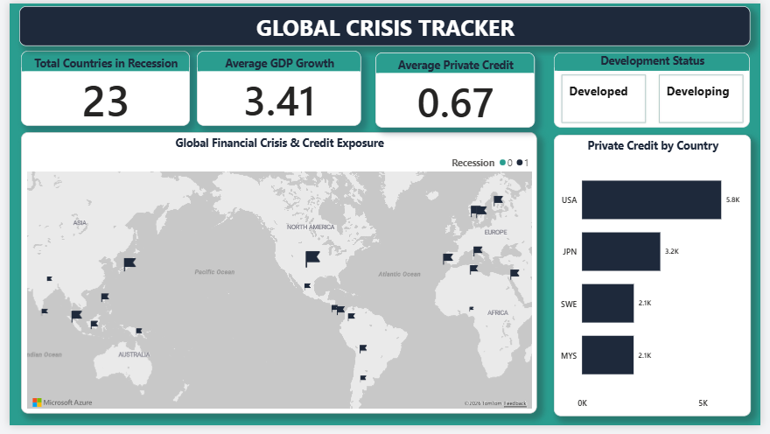
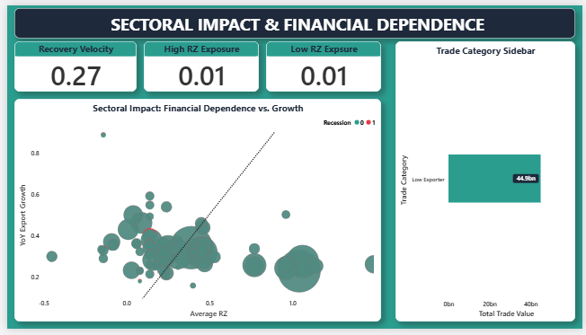
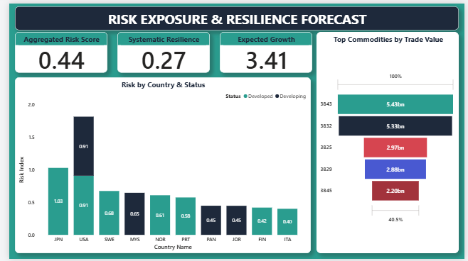
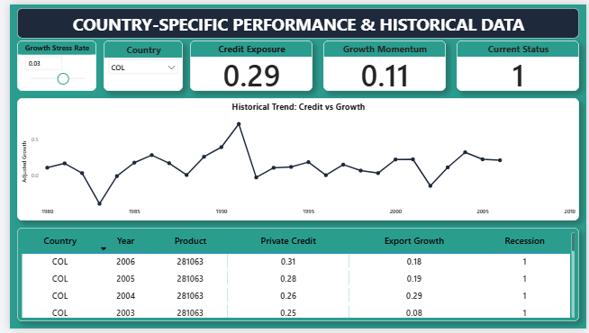
POWER BI DASHBOARD ARCHITECTURE

Slide 8
RECOMMENDATIONS
Strategic Policy Interventions for Trade Resilience
01
Prioritize Liquidity for High-RZ Sectors
Industries with high financial dependence (RZ) show the most significant growth volatility. Policy interventions like liquidity support (liqsup) should be targeted specifically at these sectors to prevent total trade collapse during crises.
02
Strengthen Credit Buffers in Developing Nations
Developed countries have significantly higher private credit (USA: 5.8K vs Malaysia: 2.1K). Developing nations should focus on increasing banking depth (pcrdbofgdp) to improve Systematic Resilience above the current 0.27 baseline.
03
Diversify Beyond High-Value Commodities
Top two products (3843 and 3832) account for over $10bn in trade, creating concentration risk. Countries should diversify export portfolios to mitigate the 0.44 Aggregated Risk from sector-specific shocks.

Slide 9
THANK YOU
Global Export Resilience: Analysing the Impact of Banking Crises and Policy Interventions
Group C · DSA3050 · USIU-Africa
Angela Irungu · Martin Kyaremateng · Queen Kibegi · Tumaini Micheni · Leona Kamau
Data Source: World Bank Data Catalog — Banking Crisis and Exports Dataset

